Slide 1
Unit 4

Slide 2
reflection

Slide 3
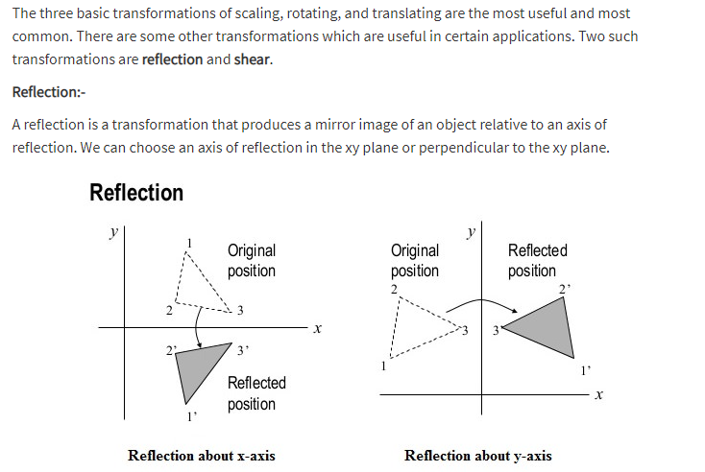

Slide 4
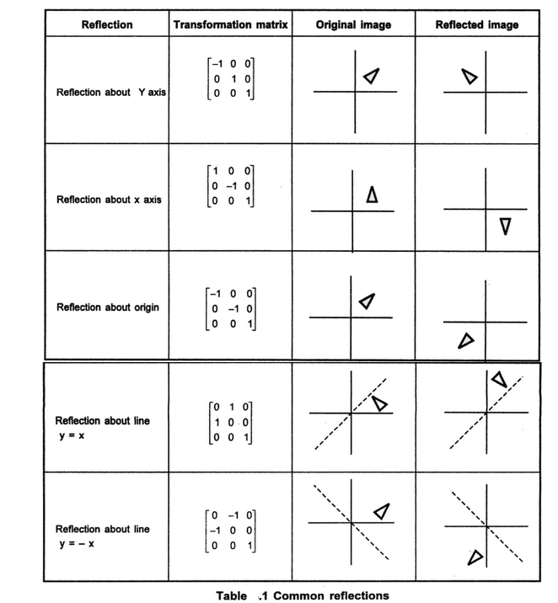

Slide 5
Shear

Slide 6
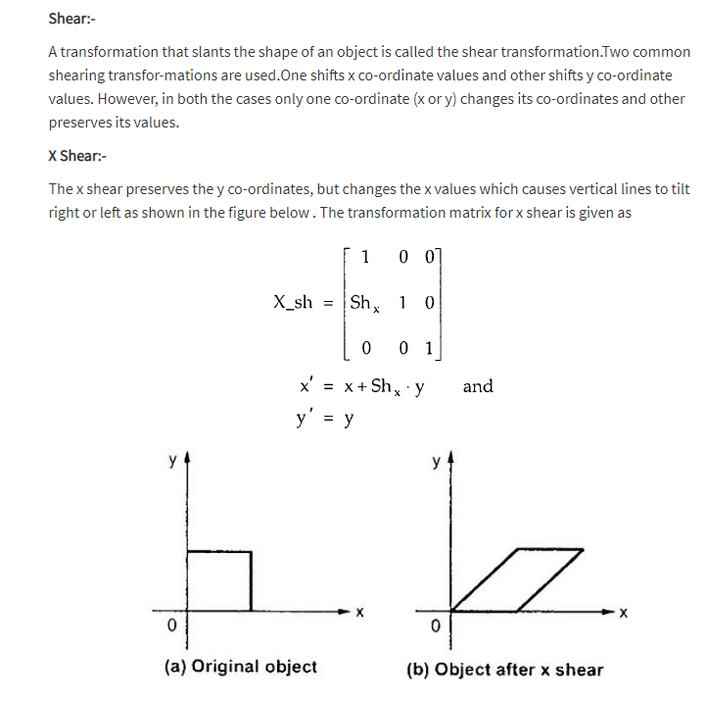

Slide 7
